Slide 1

Climate Data Archival and Analysis System: Design and Implementation Report
by Eleanya Ude

Slide 2
Introduction and Background
Purpose
Key Features
The objective of this project was to design and implement a Climate Data Archival and Analysis System. This system aims to efficiently store and retrieve vast amounts of time-series climate data, enabling comprehensive analysis and insights.
The system incorporates key features such as efficient storage of time-series data, B+-tree indexing for fast querying, and a user-friendly Flask-based API for seamless interaction.

Slide 3

System Design Goals
1
Efficient Storage
2
Fast Querying
The system prioritizes efficient storage through delta encoding and compression techniques, minimizing storage requirements and maximizing data density.
B+-tree indexing enables rapid querying and retrieval of data, supporting various data access patterns and enabling near real-time analysis.
3
Aggregation Operations
4
User-Friendly API
The system facilitates aggregation operations like average, sum, minimum, and maximum values for specific data periods, providing valuable insights into climate trends.
A Flask-based API provides a user-friendly interface for interacting with the system, allowing users to perform data operations and retrieve results with ease.

Slide 4
Methodology and Techniques
Data Compression
B+-Tree Indexing
Delta encoding is employed to compress data by storing only changes from the previous value, reducing storage space and improving query performance. This technique is particularly effective for time-series data with minimal variations.
B+-tree indexing leverages a balanced tree structure to facilitate efficient data access. This structure guarantees O(log n) time complexity for insertion, deletion, and retrieval operations, making it suitable for large datasets.

Slide 5
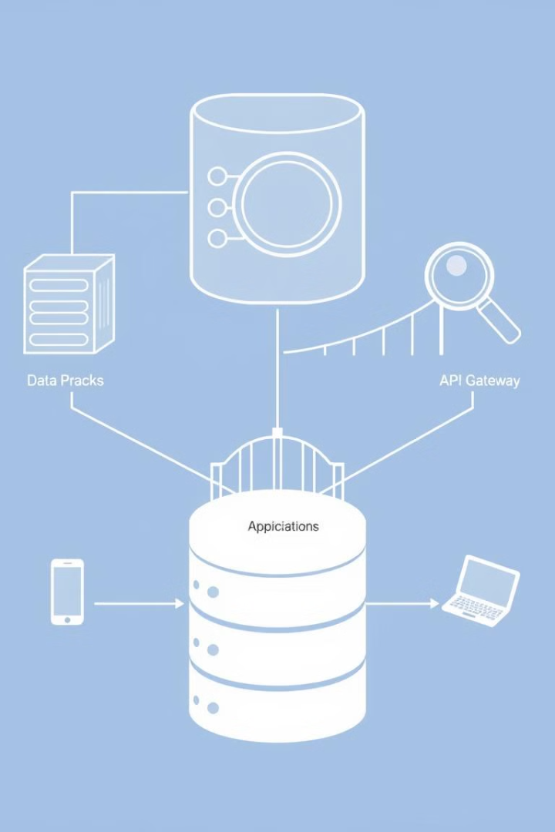


System Implementation
Database Operations
Flask API Endpoints
The system supports fundamental database operations like insertion, retrieval, update, deletion, and aggregation queries. It also implements downsampling functionalities for efficient visualization of large datasets.
A Flask-based API provides several endpoints for user interaction. These endpoints include '/insert', '/retrieve', '/update', '/delete', '/aggregate', and '/downsample', enabling users to perform various operations on the climate data.

Slide 6
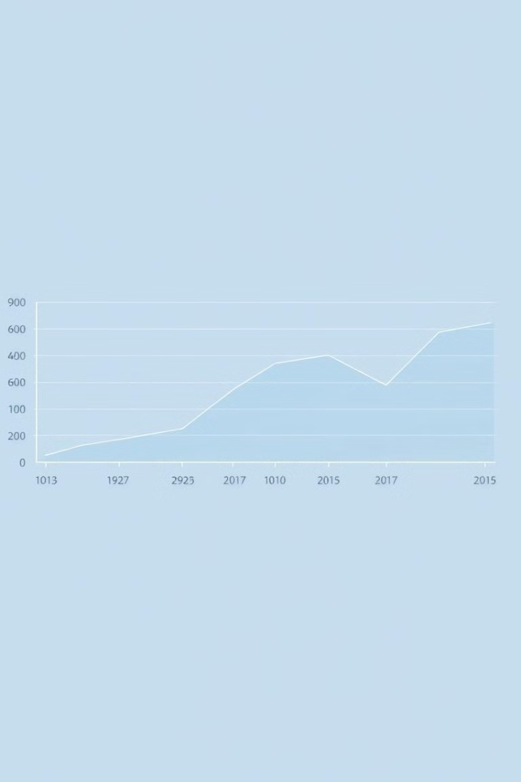
Evaluation
100%
100%
Performance
Edge Cases
The system demonstrates efficient performance for data insertions and range queries, leveraging the B+-tree indexing. The system consistently achieves near real-time response times for data retrieval.
The system effectively handles high data volumes and duplicate timestamps, ensuring robust performance and data integrity. It incorporates error handling mechanisms to gracefully manage potential data inconsistencies.

Slide 7



Analysis and Implications
Efficient Storage
1
Compression techniques significantly reduce storage requirements, minimizing the cost and resource consumption associated with managing large climate datasets.
Scalable Retrieval
2
B+-tree indexing enables efficient retrieval of specific data points or ranges, facilitating in-depth analysis and exploration of historical climate patterns.
Real-time Interaction
3
The user-friendly API provides real-time interaction with the system, allowing for quick data access and analysis, supporting dynamic exploration of climate data and trends.

Slide 8
Conclusion and Future Work
Conclusion
1
The implemented system successfully achieves its goals of efficient storage, fast data retrieval, and meaningful data analysis. It provides a foundation for comprehensive climate data management and analysis.
Future Work
Future directions for this project include exploring more advanced compression methods, integrating machine learning algorithms for anomaly detection, and scaling the system to robust database solutions like PostgreSQL or InfluxDB.
2

